Slide 1

HaclOSsim
Alessio Mantineo 324267
Francesco Marrapodi 332062
Mikhael Russo 329165
Ming Su 330532
Notes:
The assignment involves acquiring proficiency in utilizing an embedded operating system on an ISA
simulator, specifically QEMU , and customizing it to implement a new, straightforward feature, followed
by an evaluation on significant workloads

Slide 2



Workspace set up
Install QEMU
Install Arm-toolchain for embedded systems
DOWNLOAD AND Compile FreeRTOS files

Slide 3

Ubuntu
Create
Create a virtual machine
Download VirtualBox
Download Ubuntu ISO
Follow VirtualBox instructions
Install
Install QEMU with its dependencies

Slide 4
Ubuntu
Install
Install QEMU with its dependencies
sudo apt install build-essential pkg-config zlib1g-dev libglib2.0-dev autoconf libtool libsdl1.2-dev
sudo-get install qemu-system
Install
Install ARM GNU TOOLCHAIN GCC, GDB/MULTIARCH GDB

Slide 5
Ubuntu
Install
Install ARM GNU TOOLCHAIN GCC, GDB/MULTIARCH GDB
sudo apt install arm-none-eabi-gcc
sudo apt install arm-none-eabi-gdb
gdb-multiarch
Create
Create a QEMU specific SHELL path

Slide 6
Ubuntu
Create
Create a QEMU specific SHELL path
which qemu-system-arm
sudo nano ̃ /.bashrc
export PATH=/path/to/qemu/directory:$PATH
Download
Download FreeRTOS Project files

Slide 7
Ubuntu
Download
Download FreeRTOS Project files
Compile
Compile FreeRTOS project files

Slide 8
Ubuntu
Compile
Compile FreeRTOS project files
FreeRTOS/Demo/CORTEX_MPS2_QEMU_IAR_GCC/main.c
mainCREATE_SIMPLE_BLINKY_DEMO_ONLY
FreeRTOS/Demo/CORTEX_MPS2_QEMU_IAR_GCC/build/gcc
Run
Run FreeRTOS demo on QEMU

Slide 9
Ubuntu
Run
Run FreeRTOS demo on QEMU
FreeRTOS/Demo/CORTEX_MPS2_QEMU_IAR_GCC/build/gcc/output
qemu-system-arm -machine mps2-an385 -cpu cortex-m3 -kernel RTOSDemo.out -monitor none -nographic -serial stdio -s -S
Link
Link the GDB with the running demo
Notes:
- __−machine mps2−an385__:
specifies the model of the machine to emulate, in this case an ARM MPS2 development board
with a Cortex-M3 CPU.
- __-cpu cortex-m3__:
specifies the type of CPU to emulate, in this case a Cortex-M3 CPU that is an ARMv7-M
CPU.
- __−kernel [path-to]/RTOSDemo.out__:
specifies the file that contains the kernel or the firmware to load and run on the emulated
machine, in this case a file called RTOSDemo.out that is located in a certain folder.
- __−monitor none__:
disables the monitor of QEMU, which is an interactive console that allows you to control and
monitor the emulated machine.
- __-nographic__:
disables the graphics of QEMU, which is a window that shows the video output of the emulated
machine.
- __-serial stdio__:
redirects the serial output of the emulated machine to the standard input/output of the terminal
that runs QEMU, so that you can interact with the emulated machine through the terminal.
- __−s__:
enables a GDB server on port 1234, which allows you to debug the emulated machine through
a GDB client.
- __−S__:
freezes the CPU at startup, so that you can start the emulated machine only after connecting
it to the GDB client.

Slide 10
Ubuntu
Link
Link the GDB with the running demo
gdb [path-to]/RTOSDemo.out
target remote localhost:1234

Slide 11

MacOSX
Install BREW
Install QEMU
Install ARM GNU TOOLCHAIN
Create a QEMU shell path
Use Visual Studio Code for building, running and debugging the FreeRTOS demo with QEMU
Download FreeRTOS project files

Slide 12

Windows
Install MYSYS2
Download QEMU source code from MYSYS
Install arm-none-eabi-gcc compiler
Download FreeRTOS project files
Add the path to your arm-none-eabi-gcc compiler
Install Cmake
Build , run and debug the FreeRTOS demo with QEMU
Questa foto di Autore sconosciuto è concesso in licenza da CC BY-SA

Slide 13
3 IMPORTANT ELEMENTS:
- SEMAPHORE
- QUEUE
- EVENT GROUP

Slide 14
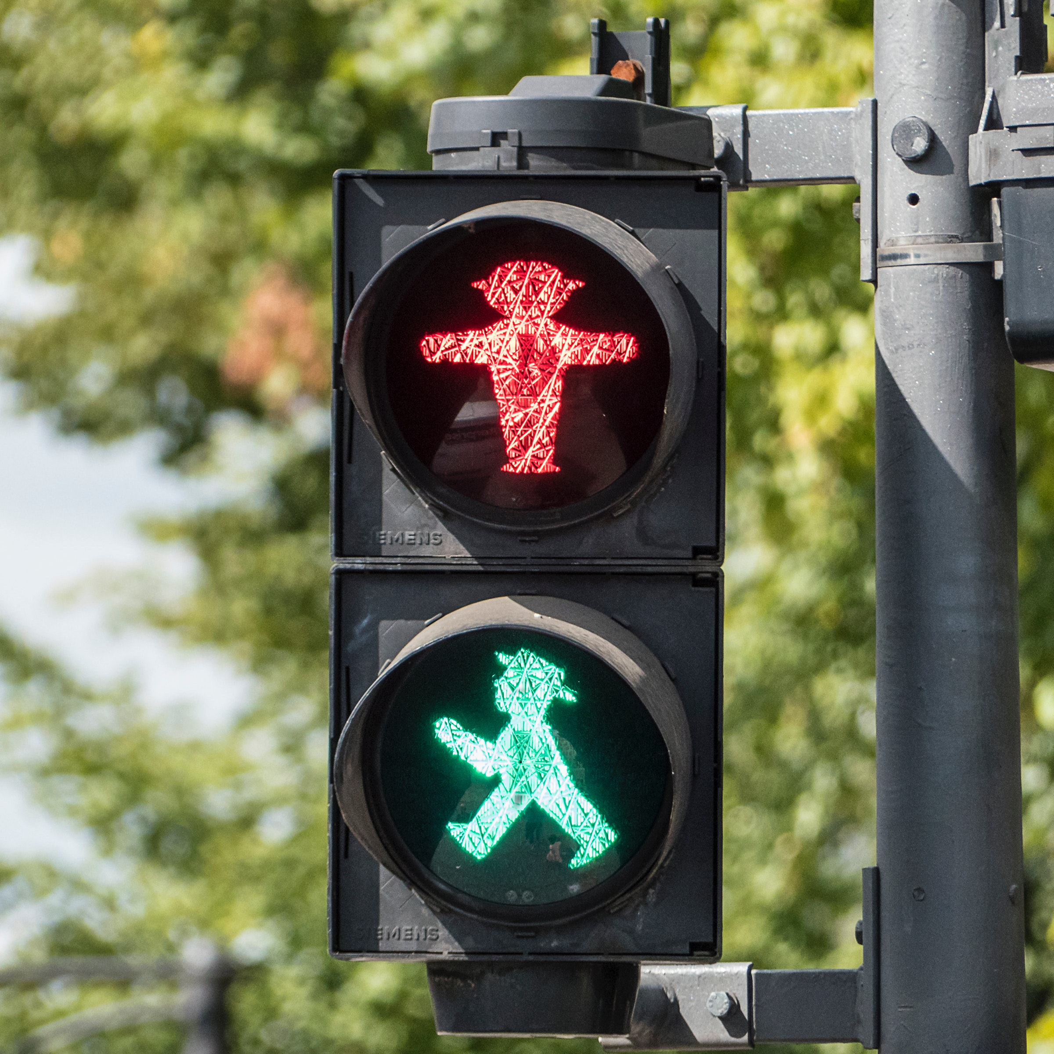
SEMAPHORE
A semaphore is a synchronization primitive used to control access to shared resources in a concurrent system.
Tasks call xSemaphoreTake() to acquire the semaphore and xSemaphoreGive() to release it.
xSemaphoreCreateMutex() is a function in FreeRTOS used to create a mutex (mutual exclusion semaphore).
When a task successfully acquires the mutex using xSemaphoreTake(), the count becomes 0, indicating that the mutex is locked.
It plays a crucial role in synchronizing access to critical sections of code in multitasking environments.

Slide 15

QUEUE
xQueueCreate()
It initializes and allocates memory for a queue data structure based on the specified parameters. Queues are fundamental constructs for inter-task communication and play a crucial role in building reliable and scalable embedded systems.
uxQueueLength:
Specifies the maximum number of items the queue can hold.
uxItemSize:
Specifies the size (in bytes) of each item in the queue.

Slide 16
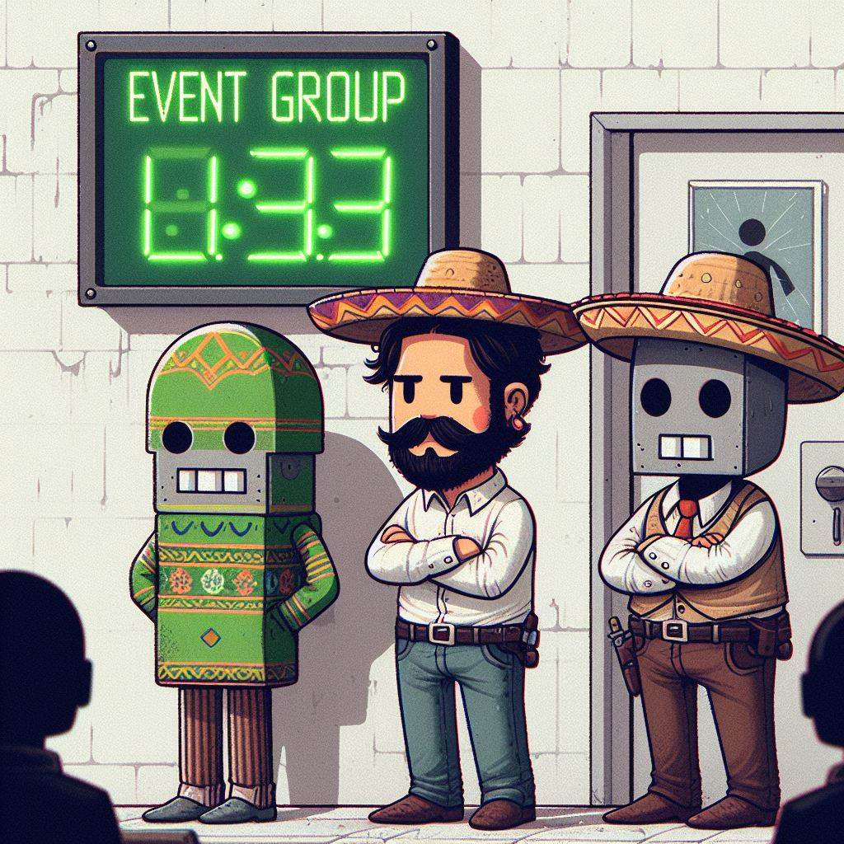
EVENT GROUP
An event group is a synchronization primitive that allows tasks to wait for a combination of events to occur before proceeding.
Implementation:
xEventGroupCreate() dynamically allocates memory for the event group data structure.
The event group data structure maintains a set of flags or bits, each representing a specific event or condition.
Tasks can wait for a combination of these bits to be set or cleared using various event group synchronization functions.
Key Functions:
xEventGroupSetBits():
Sets one or more bits in the event group.
xEventGroupClearBits():
Clears one or more bits in the event group.
xEventGroupWaitBits():
Waits for one or more specified bits to be set or cleared within the event group.
xEventGroupGetBits():
Returns the current value of the event group bits without modifying them.

Slide 17
CODE EXAMPLE
01 example_task1.c
This example illustrates a simplified model of a process queue, where tasks (processes) access a shared resource based on their position within the queue.
02
This example demonstrates a priority-based resource allocation model, where tasks are granted access to a shared resource based on their priority levels.
03
This example demonstrates the coordination of shared resource access among multiple tasks using a combination of semaphore and event group mechanisms in FreeRTOS.
CASE STUDY
In a manufacturing plant, multiple automated processes need controlled access to a critical resource. The processes must efficiently utilize the robotic arm while avoiding collisions and resource contention.
System Components
Tasks: Represent automated processes (e.g., assembly, quality checks).
Resource: Represents the robotic arm utilized for assembly tasks.
FreeRTOS: Embedded real-time operating system facilitating task management.

Slide 18
CODE EXAMPLE
01
This example illustrates a simplified model of a process queue, where tasks (processes) access a shared resource based on their position within the queue.
02 example_task2.c
This example demonstrates a priority-based resource allocation model, where tasks are granted access to a shared resource based on their priority levels.
03
This example demonstrates the coordination of shared resource access among multiple tasks using a combination of semaphore and event group mechanisms in FreeRTOS.
CASE STUDY
In a manufacturing plant, multiple automated processes need controlled access to a critical resource. The processes must efficiently utilize the robotic arm while avoiding collisions and resource contention.
System Components
Tasks: Represent automated processes (e.g., assembly, quality checks).
Resource: Represents the robotic arm utilized for assembly tasks.
FreeRTOS: Embedded real-time operating system facilitating task management.

Slide 19
CODE EXAMPLE
01
This example illustrates a simplified model of a process queue, where tasks (processes) access a shared resource based on their position within the queue.
02
This example demonstrates a priority-based resource allocation model, where tasks are granted access to a shared resource based on their priority levels.
03 example_task3.c
This example demonstrates the coordination of shared resource access among multiple tasks using a combination of semaphore and event group mechanisms.
CASE STUDY
In a manufacturing plant, multiple automated processes need controlled access to a critical resource. The processes must efficiently utilize the robotic arm while avoiding collisions and resource contention.
System Components
Tasks: Represent automated processes (e.g., assembly, quality checks).
Resource: Represents the robotic arm utilized for assembly tasks.
FreeRTOS: Embedded real-time operating system facilitating task management.

Slide 20
Example_task1.c
Semaphore (resourceSemaphore):
Created as a mutex to control access to the shared resource.
Ensures mutual exclusion, allowing only one task to access the resource at a time.
Initialized and given to indicate availability for resource access.
Resource Initialization and Task Creation
void main_task1(void) {
resourceSemaphore = xSemaphoreCreateMutex();
xSemaphoreGive(resourceSemaphore);
accessQueue = xQueueCreate(QUEUE_LENGTH, sizeof(TaskHandle_t));
for (int i = 0; i < 7; i++) {
xTaskCreate(accessResourceTask, "Access Task", ACCESS_TASK_SATCK_SIZE, NULL, TASK_PRIORITY, NULL);
}
vTaskStartScheduler();
while (1) {
// Error handling or additional operations
}
}

Slide 21
Example_task1.c
Semaphore (resourceSemaphore):
Created as a mutex to control access to the shared resource.
Ensures mutual exclusion, allowing only one task to access the resource at a time.
Initialized and given to indicate availability for resource access.
Resource Initialization and Task Creation
void main_task1(void) {
resourceSemaphore = xSemaphoreCreateMutex();
xSemaphoreGive(resourceSemaphore);
accessQueue = xQueueCreate(QUEUE_LENGTH, sizeof(TaskHandle_t));
for (int i = 0; i < 7; i++) {
xTaskCreate(accessResourceTask, "Access Task", ACCESS_TASK_SATCK_SIZE, NULL, TASK_PRIORITY, NULL);
}
vTaskStartScheduler();
while (1) {
// Error handling or additional operations
}
}
Queue (accessQueue):
Created to store the order of task arrival, facilitating sequential access to the resource.
Allows tasks to enqueue themselves upon arrival, enabling orderly processing and synchronization.

Slide 22
Example_task1.c
Semaphore (resourceSemaphore):
Created as a mutex to control access to the shared resource.
Ensures mutual exclusion, allowing only one task to access the resource at a time.
Initialized and given to indicate availability for resource access.
Resource Initialization and Task Creation
void main_task1(void) {
resourceSemaphore = xSemaphoreCreateMutex();
xSemaphoreGive(resourceSemaphore);
accessQueue = xQueueCreate(QUEUE_LENGTH, sizeof(TaskHandle_t));
for (int i = 0; i < 7; i++) {
xTaskCreate(accessResourceTask, "Access Task", ACCESS_TASK_SATCK_SIZE, NULL, TASK_PRIORITY, NULL);
}
vTaskStartScheduler();
while (1) {
// Error handling or additional operations
}
}
Queue (accessQueue):
Created to store the order of task arrival, facilitating sequential access to the resource.
Allows tasks to enqueue themselves upon arrival, enabling orderly processing and synchronization.
The xTaskCreate() function is used to create tasks with the following parameters:
Task function: accessResourceTask
Task name: "Access Task"
Stack size: ACCESS_TASK_SATCK_SIZE
Task parameter: NULL
Task priority: TASK_PRIORITY

Slide 23
Example_task1.c
Queue Operations:
Tasks enqueue their handles in the accessQueue upon arrival to indicate their readiness for resource access.
They then dequeue a task handle from the queue to proceed with resource access.
Semaphore Acquisition:
Tasks attempt to acquire the resourceSemaphore (mutex) for exclusive access to the shared resource.
The semaphore ensures mutual exclusion, allowing only one task to access the resource at a time.
static void accessResourceTask(void *pvParameters) {
(void)pvParameters;
TaskHandle_t currentTask = xTaskGetCurrentTaskHandle();
if (xQueueSend(accessQueue, &currentTask, portMAX_DELAY) == pdPASS) {
TaskHandle_t taskInQueue;
if (xQueueReceive(accessQueue, &taskInQueue, portMAX_DELAY) == pdPASS) {
if (currentTask == taskInQueue) {
if (xSemaphoreTake(resourceSemaphore, portMAX_DELAY) == pdTRUE) {
vTaskDelay(pdMS_TO_TICKS(100));
taskENTER_CRITICAL();
TaskStatus_t taskStatus;
vTaskGetInfo(currentTask, &taskStatus, pdTRUE, eInvalid);
int taskId = taskStatus.xTaskNumber;
useResource(taskId);
xSemaphoreGive(resourceSemaphore); vQueueUnregisterQueue(accessQueue);
taskEXIT_CRITICAL();
vTaskDelete(NULL);
}
}
}
}
vTaskDelay(pdMS_TO_TICKS(1000));
}
Resource Utilization:
Upon acquiring the semaphore, tasks proceed to use the shared resource, simulating their functionality.
The resource usage is simulated by invoking the useResource function with the task ID.
Resource Release and Task Deletion:
After utilizing the resource, tasks release the semaphore to allow other tasks to access the resource.
They unregister from the accessQueue and delete themselves after completing resource usage.

Slide 24
Example_task1.c
Queue Operations:
Tasks enqueue their handles in the accessQueue upon arrival to indicate their readiness for resource access.
They then dequeue a task handle from the queue to proceed with resource access.
Semaphore Acquisition:
Tasks attempt to acquire the resourceSemaphore (mutex) for exclusive access to the shared resource.
The semaphore ensures mutual exclusion, allowing only one task to access the resource at a time.
static void accessResourceTask(void *pvParameters) {
(void)pvParameters;
TaskHandle_t currentTask = xTaskGetCurrentTaskHandle();
if (xQueueSend(accessQueue, &currentTask, portMAX_DELAY) == pdPASS) {
TaskHandle_t taskInQueue;
if (xQueueReceive(accessQueue, &taskInQueue, portMAX_DELAY) == pdPASS) {
if (currentTask == taskInQueue) {
if (xSemaphoreTake(resourceSemaphore, portMAX_DELAY) == pdTRUE) {
vTaskDelay(pdMS_TO_TICKS(100));
taskENTER_CRITICAL();
TaskStatus_t taskStatus;
vTaskGetInfo(currentTask, &taskStatus, pdTRUE, eInvalid);
int taskId = taskStatus.xTaskNumber;
useResource(taskId);
xSemaphoreGive(resourceSemaphore); vQueueUnregisterQueue(accessQueue);
taskEXIT_CRITICAL();
vTaskDelete(NULL);
}
}
}
}
vTaskDelay(pdMS_TO_TICKS(1000));
}
Resource Utilization:
Upon acquiring the semaphore, tasks proceed to use the shared resource, simulating their functionality.
The resource usage is simulated by invoking the useResource function with the task ID.
Resource Release and Task Deletion:
After utilizing the resource, tasks release the semaphore to allow other tasks to access the resource.
They unregister from the accessQueue and delete themselves after completing resource usage.

Slide 25
Example_task1.c
Queue Operations:
Tasks enqueue their handles in the accessQueue upon arrival to indicate their readiness for resource access.
They then dequeue a task handle from the queue to proceed with resource access.
Semaphore Acquisition:
Tasks attempt to acquire the resourceSemaphore (mutex) for exclusive access to the shared resource.
The semaphore ensures mutual exclusion, allowing only one task to access the resource at a time.
static void accessResourceTask(void *pvParameters) {
(void)pvParameters;
TaskHandle_t currentTask = xTaskGetCurrentTaskHandle();
if (xQueueSend(accessQueue, &currentTask, portMAX_DELAY) == pdPASS) {
TaskHandle_t taskInQueue;
if (xQueueReceive(accessQueue, &taskInQueue, portMAX_DELAY) == pdPASS) {
if (currentTask == taskInQueue) {
if (xSemaphoreTake(resourceSemaphore, portMAX_DELAY) == pdTRUE) {
vTaskDelay(pdMS_TO_TICKS(100));
taskENTER_CRITICAL();
TaskStatus_t taskStatus;
vTaskGetInfo(currentTask, &taskStatus, pdTRUE, eInvalid);
int taskId = taskStatus.xTaskNumber;
useResource(taskId);
xSemaphoreGive(resourceSemaphore); vQueueUnregisterQueue(accessQueue);
taskEXIT_CRITICAL();
vTaskDelete(NULL);
}
}
}
}
vTaskDelay(pdMS_TO_TICKS(1000));
}
Resource Utilization:
Upon acquiring the semaphore, tasks proceed to use the shared resource, simulating their functionality.
The resource usage is simulated by invoking the useResource function with the task ID.
Resource Release and Task Deletion:
After utilizing the resource, tasks release the semaphore to allow other tasks to access the resource.
They unregister from the accessQueue and delete themselves after completing resource usage.

Slide 26
Example_task2.c
void taskExample2(void *pvParameters) {
int userId = (int)pvParameters;
if (xSemaphoreTake(xMutex, portMAX_DELAY)) {
useResource(userId);
xSemaphoreGive(xMutex);
taskENTER_CRITICAL();
usersCompleted++;
xQueueSendToBack(xQueue, &userId, portMAX_DELAY);
if (usersCompleted == NUM_USERS) {
int userOrder;
xEventGroupSetBits(xTask2Events, (1 << NUM_USERS) - 1);
// Notify task 3 that all users have finished
printf("Execution order: ");
while (xQueueReceive(xQueue, &userOrder, 0)) {
printf("%d ", userOrder);
}
printf("\n");
printf("\n");
}
taskEXIT_CRITICAL();
}
vTaskDelete(NULL);
}
Utilizes a mutex (xMutex) to ensure exclusive access to the shared resource.
Acquires the mutex using xSemaphoreTake() to begin resource utilization.
Releases the mutex using xSemaphoreGive() after resource usage.
Enters a critical section using taskENTER_CRITICAL() to ensure atomicity of critical operations.
Updates a counter (usersCompleted) to track the number of completed tasks.
Enqueues the user ID into a queue (xQueue) to maintain the execution order.
Notifies Task 3 when all users have finished using an event group (xTask2Events).
(Event Group (xTask2Events): Signals Task 3 when all users have finished.)

Slide 27
Example_task2.c
void taskExample2(void *pvParameters) {
int userId = (int)pvParameters;
if (xSemaphoreTake(xMutex, portMAX_DELAY)) {
useResource(userId);
xSemaphoreGive(xMutex);
taskENTER_CRITICAL();
usersCompleted++;
xQueueSendToBack(xQueue, &userId, portMAX_DELAY);
if (usersCompleted == NUM_USERS) {
int userOrder;
xEventGroupSetBits(xTask2Events, (1 << NUM_USERS) - 1);
// Notify task 3 that all users have finished
printf("Execution order: ");
while (xQueueReceive(xQueue, &userOrder, 0)) {
printf("%d ", userOrder);
}
printf("\n");
printf("\n");
}
taskEXIT_CRITICAL();
}
vTaskDelete(NULL);
}
Utilizes a mutex (xMutex) to ensure exclusive access to the shared resource.
Acquires the mutex using xSemaphoreTake() to begin resource utilization.
Releases the mutex using xSemaphoreGive() after resource usage.
Enters a critical section using taskENTER_CRITICAL() to ensure atomicity of critical operations.
Updates a counter (usersCompleted) to track the number of completed tasks.
Enqueues the user ID into a queue (xQueue) to maintain the execution order.
Notifies Task 3 when all users have finished using an event group (xTask2Events).
(Event Group (xTask2Events): Signals Task 3 when all users have finished.)

Slide 28
Example_task3.c
void taskExample3(void *pvParameters) {
int userId = (int)pvParameters;// ID user
xEventGroupWaitBits(xTask2Events, (1 << NUM_USERS) - 1, pdFALSE, pdTRUE, portMAX_DELAY); // Wait for all users to finish
if (userId <= HIGH_PRIORITY_USERS) { // High Priority User
printf("High Priority User %d is using the resource\n", userId);
highPriorityUsersDone++;
if (highPriorityUsersDone == HIGH_PRIORITY_USERS) {
// If all high priority users have finished
// Notify low priority users
for (int i = HIGH_PRIORITY_USERS; i < NUM_USERS; i++) {
xTaskNotifyGive(tasks[i]);// Notify the task
}
}
} else { // Low priority users
// Assure that all high priority users have finished
printf("Low Priority User %d is using the resource\n", userId);
}
vTaskDelete(NULL);
}
Utilizes the event group (xTask2Events) to synchronize task execution.
Waits for all users to finish using xEventGroupWaitBits() before accessing the resource.
Determines whether the user is high-priority based on user ID.
If a high-priority user, directly uses the resource and increments the count of high-priority users done.
Once all high-priority users finish, notifies low-priority users to access the resource.

Slide 29
Example_task3.c
void taskExample3(void *pvParameters) {
int userId = (int)pvParameters;// ID user
xEventGroupWaitBits(xTask2Events, (1 << NUM_USERS) - 1, pdFALSE, pdTRUE, portMAX_DELAY); // Wait for all users to finish
if (userId <= HIGH_PRIORITY_USERS) { // High Priority User
printf("High Priority User %d is using the resource\n", userId);
highPriorityUsersDone++;
if (highPriorityUsersDone == HIGH_PRIORITY_USERS) {
// If all high priority users have finished
// Notify low priority users
for (int i = HIGH_PRIORITY_USERS; i < NUM_USERS; i++) {
xTaskNotifyGive(tasks[i]);// Notify the task
}
}
} else { // Low priority users
// Assure that all high priority users have finished
printf("Low Priority User %d is using the resource\n", userId);
}
vTaskDelete(NULL);
}
Utilizes the event group (xTask2Events) to synchronize task execution.
Waits for all users to finish using xEventGroupWaitBits() before accessing the resource.
Determines whether the user is high-priority based on user ID.
If a high-priority user, directly uses the resource and increments the count of high-priority users done.
Once all high-priority users finish, notifies low-priority users to access the resource.

Slide 30
Example_task2/3.c
void main_task23() {
xMutex = xSemaphoreCreateMutex(); // Create the mutex
xQueue = xQueueCreate(NUM_USERS, sizeof(int));
xTask2Events = xEventGroupCreate();
for (int i = 0; i < NUM_USERS; i++) {
int priority = (i % 2 == 0) ? 2 : 1; // Priority of the task
xTaskCreate( // Create the task
taskExample2, // Call function
"taskExample2", // Name of the task
configMINIMAL_STACK_SIZE, // Size of the stack
(void *)i, // Parameter passed to the function
priority, // Priority of the task
NULL // Handle of the task
);
}
for (int i = 1; i <= NUM_USERS; i++) {
xTaskCreate( // Create the task
taskExample3, // Call function
"taskExample3", // Name of the task
1000, // Size of the stack
(void *)i, // Parameter passed to the function
(i <= HIGH_PRIORITY_USERS ? 2 : 1), // Priority of the task
&tasks[i - 1] // Handle of the task
);
}
vTaskStartScheduler(); // Start the scheduler
}
This function initializes the main tasks for the example scenario.
It creates a mutex (xMutex), a queue (xQueue), and an event group (xTask2Events) to manage synchronization and communication between tasks.
Tasks are then created using xTaskCreate with appropriate priorities and parameters passed to taskExample2 and taskExample3.
Notes:
TASK2
the priority variable based on whether the value of i is even or odd. Here's how it works:
(i % 2 == 0) checks if i is an even number. The modulo operator % calculates the remainder when i is divided by 2. If the remainder is 0, it means i is even.
If (i % 2 == 0) evaluates to true (meaning i is even), then the priority is set to 2.
If (i % 2 == 0) evaluates to false (meaning i is odd), then the priority is set to 1.
This ternary operator (condition) ? value_if_true : value_if_false is a shorthand way of writing an if-else statement.
TASK3
If i (the current task number) is less than or equal to HIGH_PRIORITY_USERS, the priority is set to 2 (high priority). Otherwise, it is set to 1 (low priority).
This means that the first HIGH_PRIORITY_USERS tasks created in the loop will have a priority of 2 (high priority), while the remaining tasks will have a priority of 1 (low priority).
In summary, the priority of each task is dynamically determined based on its position in the loop and the value of HIGH_PRIORITY_USERS, ensuring that high-priority tasks are created before low-priority tasks.

Slide 31

FreeRTOS Customization: Implementation of Earliest Deadline First (EDF) Scheduler

Slide 32

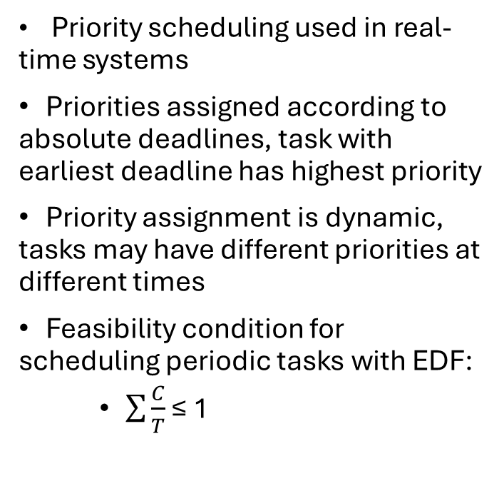
EDF Overview
Priority scheduling used in real-time systems
Priorities assigned according to absolute deadlines, task with earliest deadline has highest priority
Priority assignment is dynamic, tasks may have different priorities at different times
Feasibility condition for scheduling periodic tasks with EDF:
$\sum{\frac{C}{T}}$ ≤ 1

Slide 33

Assumptions for EDF implementation
Only periodic tasks are considered
Task deadline is equal to the task period
Only schedulable tasks set
Each task is completed inside its deadline.
Independent tasks without shared resources or synchronization issues

Slide 34
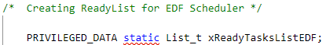
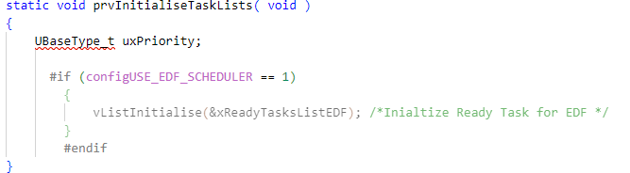
Implementation details
A new ready List (xReadyTasksListEDF) is declared;
prvInitialiseTaskLists() method is modified to initialize xReadyTasksListEDF;
prvAddTaskToReadyList() method is modified to insert tasks into xReadyTasksListEDF based on deadlines;

Slide 35
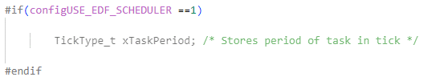
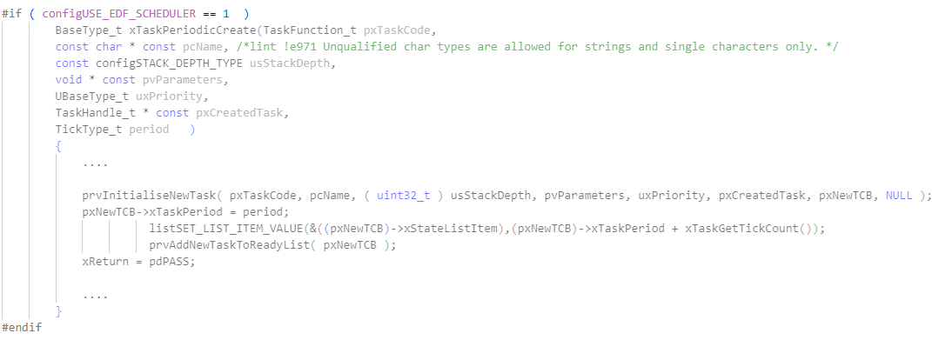
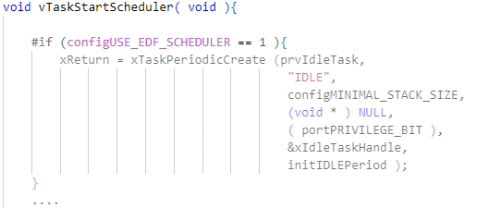
Implementation details
tskTaskControlBlock structure is updated to include xTaskPeriod variable for task periods;
New task initialization method xTaskPeriodicCreate() is created;
vTaskStartScheduler() method is modified in order to insert the IDLE task in the new list;

Slide 36
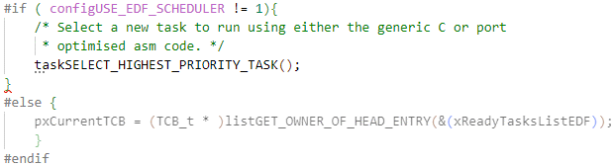
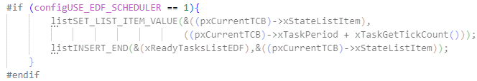
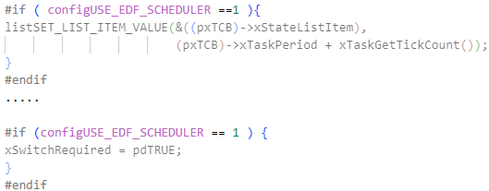
Implementation details
Context switch mechanism (vTaskSwitchContext()) is modified to update running task based on new ready List;
The IDLE task function (prvIdleTask())is modified to keep the IDLE task always at the farest deadline;
Modification of xTaskIncrementTick() ensures timely insertion of task deadlines into EDF ready list, prompting immediate context switches for new tasks.

Slide 37

Chapter 4 EDF Implementaion Testing

Slide 38
Utility.c
int main_part4(void) {
if(isSchedulable(task1_C, task1_T, task2_C, task2_T) != pdTRUE) { // Check for schedulability
return -1;
}
BaseType_t isSchedulable(float task1_C, float task1_T, float task2_C, float task2_T) {
char buffer[10];
// Calc the CPU utilization
float utilization = (task1_C / task1_T) + (task2_C / task2_T) ;
// Check the schedulability
if (utilization <= 1.0) {
floatToChar(utilization*100, buffer, 1);
printf("FEASIBLE CPU UTILIZATION: %s\n", buffer);
return pdTRUE; // The system is schedulable
} else {
floatToChar(utilization*100, buffer, 1);
printf("NOT FEASIBLE CPU UTILIZATION: %s\n ", buffer);
return pdFALSE; // The system is not schedulable
}

Slide 39
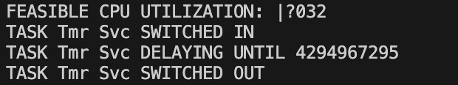
Problem of FLOAT

Slide 40
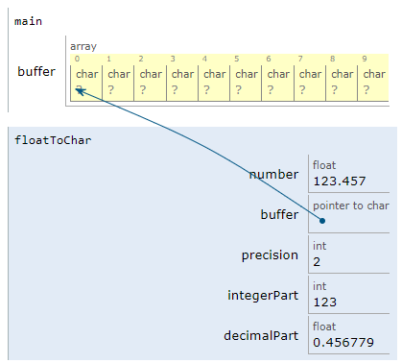
Utility.c
void floatToChar(float number, char *buffer, int precision) {
// Handle the case of a negative number
if (number < 0) { // If the number is negative
*buffer++ = '-'; // Add the negative sign
number = -number; // Make the number positive
}
// Take the integer part
int integerPart = (int)number; // Integer part
float decimalPart = number - (float)integerPart; // Decimal part
// Convert the integer part
sprintf(buffer, "%d", integerPart); // Convert the integer part
// Find the end of the string
while (*buffer != '\0') { // Search for the end of the string
buffer++; // Move the pointer
}
*buffer++ = '.'; // Add the decimal point
// Convert the decimal part
for (int i = 0; i < precision; i++) { // For the number of decimal places
decimalPart *= 10; // Multiply the decimal part by 10
int num = (int)decimalPart; // Get the integer part
*buffer++ = (char)('0' + num); // Add the integer part to the string
decimalPart -= num; // Subtract the integer part from the decimal part
}
// Terminate the string
*buffer = '\0';
}

Slide 41
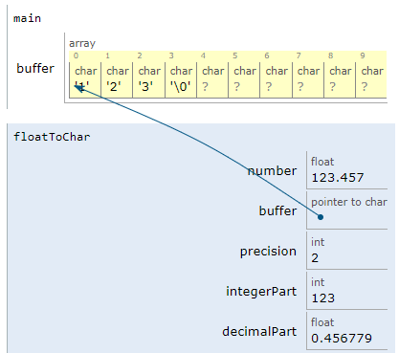
Utility.c
void floatToChar(float number, char *buffer, int precision) {
// Handle the case of a negative number
if (number < 0) { // If the number is negative
*buffer++ = '-'; // Add the negative sign
number = -number; // Make the number positive
}
// Take the integer part
int integerPart = (int)number; // Integer part
float decimalPart = number - (float)integerPart; // Decimal part
// Convert the integer part
sprintf(buffer, "%d", integerPart); // Convert the integer part
// Find the end of the string
while (*buffer != '\0') { // Search for the end of the string
buffer++; // Move the pointer
}
*buffer++ = '.'; // Add the decimal point
// Convert the decimal part
for (int i = 0; i < precision; i++) { // For the number of decimal places
decimalPart *= 10; // Multiply the decimal part by 10
int num = (int)decimalPart; // Get the integer part
*buffer++ = (char)('0' + num); // Add the integer part to the string
decimalPart -= num; // Subtract the integer part from the decimal part
}
// Terminate the string
*buffer = '\0';
}

Slide 42
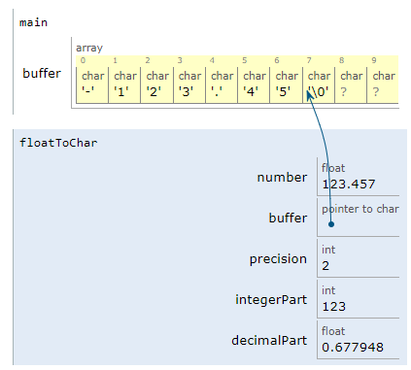
Utility.C
void floatToChar(float number, char *buffer, int precision) {
// Handle the case of a negative number
if (number < 0) { // If the number is negative
*buffer++ = '-'; // Add the negative sign
number = -number; // Make the number positive
}
// Take the integer part
int integerPart = (int)number; // Integer part
float decimalPart = number - (float)integerPart; // Decimal part
// Convert the integer part
sprintf(buffer, "%d", integerPart); // Convert the integer part
// Find the end of the string
while (*buffer != '\0') { // Search for the end of the string
buffer++; // Move the pointer
}
*buffer++ = '.'; // Add the decimal point
// Convert the decimal part
for (int i = 0; i < precision; i++) { // For the number of decimal places
decimalPart *= 10; // Multiply the decimal part by 10
int num = (int)decimalPart; // Get the integer part
*buffer++ = (char)('0' + num); // Add the integer part to the string
decimalPart -= num; // Subtract the integer part from the decimal part
}
// Terminate the string
*buffer = '\0';
}

Slide 43
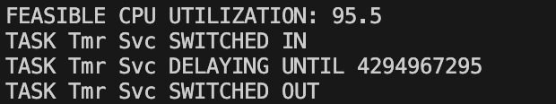
After the implementation

Slide 44
xTaskPeriodicCreate
TaskFunction_t pxTaskCode,
const char * const pcName,
const configSTACK_DEPTH_TYPE usStackDepth,
void * const pvParameters,
UBaseType_t uxPriority,
TaskHandle_t * const pxCreatedTask,
TickType_t period
pxTaskCode: Is a pointer to the function that will be executed as a task.
pcName: A string that represents the name of the task.
usStackDepth: The size of the stack assigned to the task. This parameter determines how much space is reserved for the task's local variables.
pvParameters: A pointer to the parameters that will be passed to the task at the time of its execution.
uxPriority: The priority of the task. In an RTOS, tasks with higher priority are executed before those with lower priority.
pxCreatedTask: A pointer to an identifier for the task. It can be used later to refer to the task, for example to suspend or delete the task.
period: The period with which the task should be executed. This value is typically expressed in "ticks" of the system clock.

Slide 45
void TSK_A(void *pvParameters) {
TickType_t xLastWakeTime = xTaskGetTickCount(); // Initialize the task's temporal base
while (1) {
// SImulate the execution time of the task
xTaskDelayUntil(&xLastWakeTime, task1_T);
}
}
void TSK_B(void *pvParameters) {
TickType_t xLastWakeTime = xTaskGetTickCount(); // Initialize the task's temporal base
while (1) {
// Simulate the execution time of the task
xTaskDelayUntil(&xLastWakeTime, task2_T);
}
}
Pointer xLastWakeTime: Stores the last wake time of the task. The function uses this value to calculate when the task should run next
Value task2_C: represents the number of tick of the task should wait before it is scheduled to run again

Slide 46
#define traceTASK_SWITCHED_OUT() { \
printf("TASK %s SWITCHED OUT\n", pcTaskGetName(NULL)); \
}
#define traceTASK_SWITCHED_IN() { \
printf("TASK %s SWITCHED IN\n", pcTaskGetName(NULL)); \
}
#define traceTASK_DELAY_UNTIL(xTimeToWake) { \
printf("TASK %s DELAYING UNTIL %u \n", pcTaskGetName(NULL), (unsigned int)xTimeToWake); \
}

Slide 47
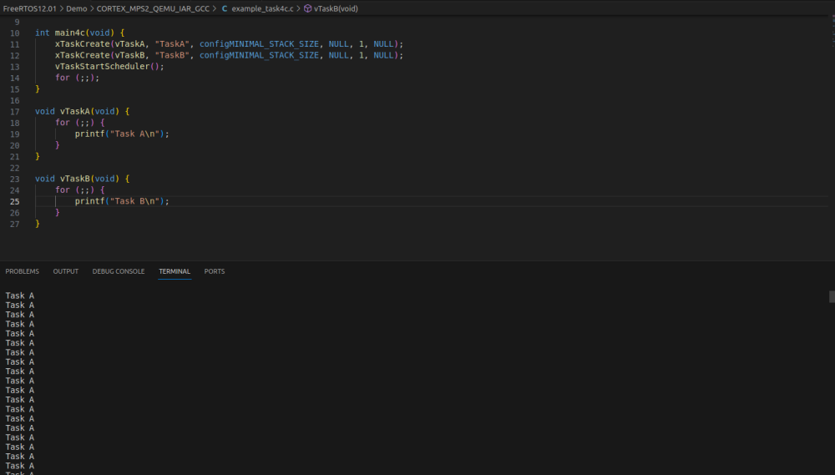
WITHOUT EDF
Task B never Execute

Slide 48
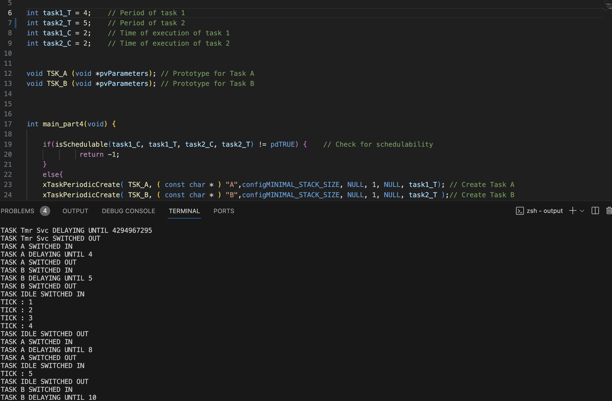
WITH EDF
Task A & Task B are interleaved with a specific T and C

Slide 49

Thanks for the attention

